Slide 1
CS450 Tutorial Session 1
Android and IOIO Board

Slide 2
An Overview of Tricorder
Android Phone
IOIO Board
Tmote(Probe)
Tmote(Bridge)
Sensors
*Tmote=telosb
*Android Phone=Droid

Slide 3
Why we need IOIO Board?
A pervasive device: Android Phone
Need a low power radio to control and communicate with a Tmote
How? The answer is IOIO Board.

Slide 4
What is an IOIO Board
The IOIO (pronounced "yo-yo") is a board specially designed to work with an Android device to provide extensive and robust connectivity to an Android device via a USB connection.
In this semester we’ll use IOIO Board to connect an Android phone and a Tmote through serial connections. (Android to IOIO Board through Android Debug Bridge(ADB) and IOIO Board to Tmote through Uart)
*IOIO Board need a 5-15V 1A power supply. In this project we use both Droid and Tmote(bridge) to supply the power for IOIO Board. Since Tmote(bridge) only provide 500mA of maximum output current, you need to make sure your Droid is fully charged.

Slide 5
Create an Android Project
While Learning to set up Eclipse-ADK and TinyOS Dev-Env is highly recommended, we provide a Ready-To-Use Vmware Image with which you can load onto your vmware player andAll those environment things are setup for you with one-click and tutorials already loaded into the Eclipse.

Slide 6
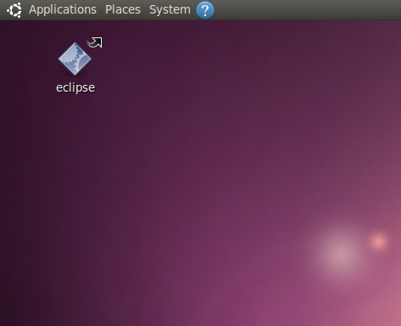
Start Eclipse on the desktop

Slide 7
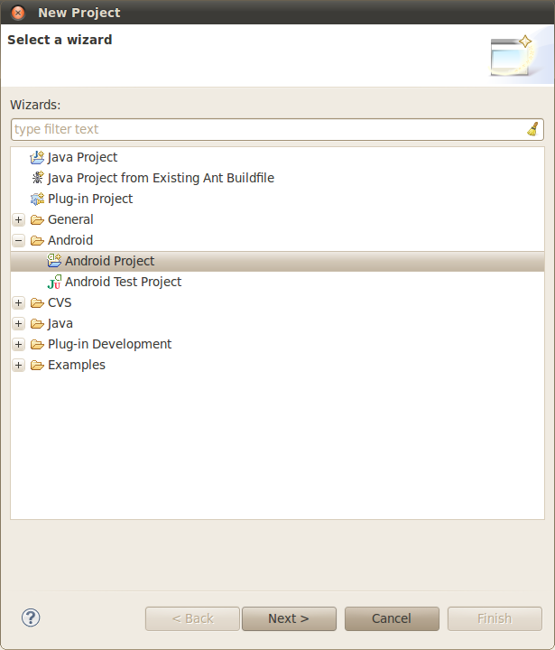
Create an Android Project
Menu: File->New->Project
From "Android" Select Android Project (Fig 1)

Slide 8
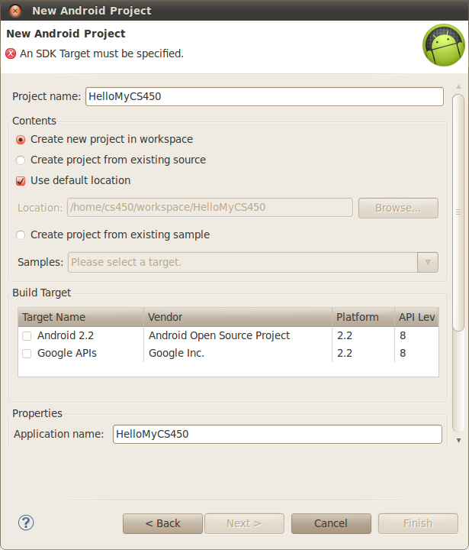
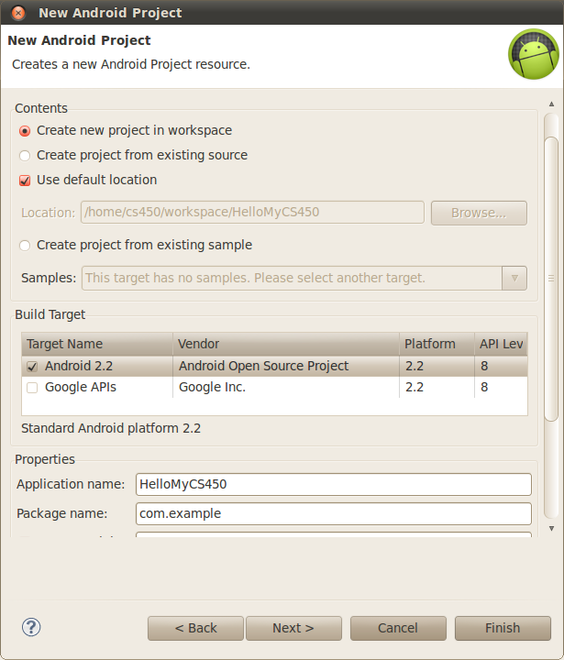
Create an Android Project
Type in the "Project Name" with HelloMyCS450
In "Build Target" Select "Android 2.2"
Scroll Down the Window
In "Properties" fill in "Package name" with "com.example"
Click on "Finish"

Slide 9
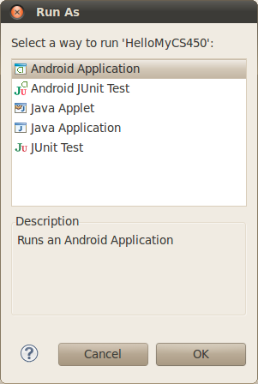
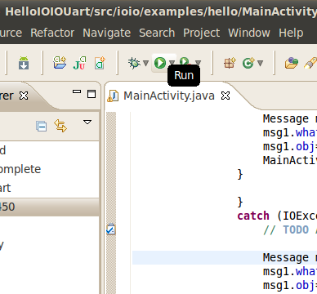
Run an Android Project

Slide 10
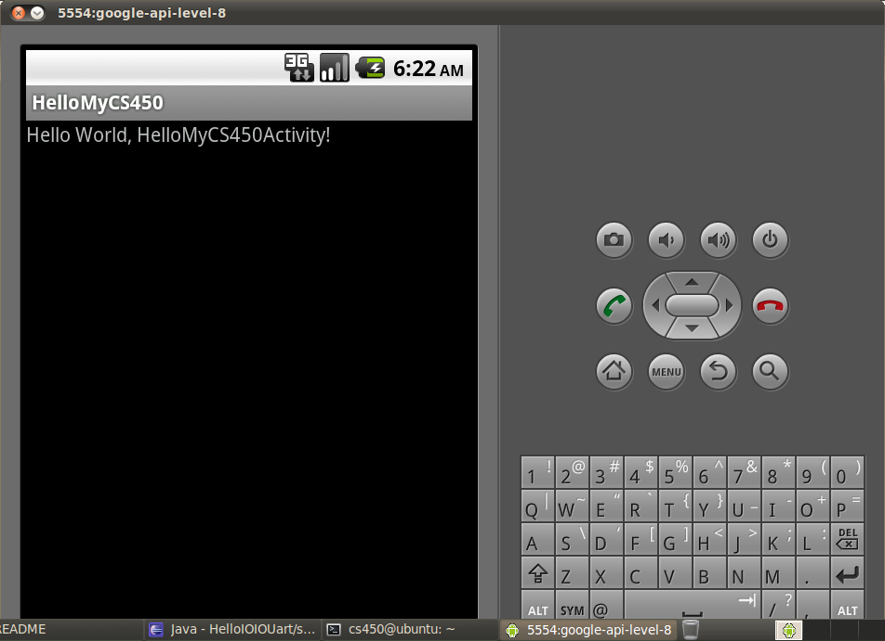
A glance at a Hello World

Slide 11
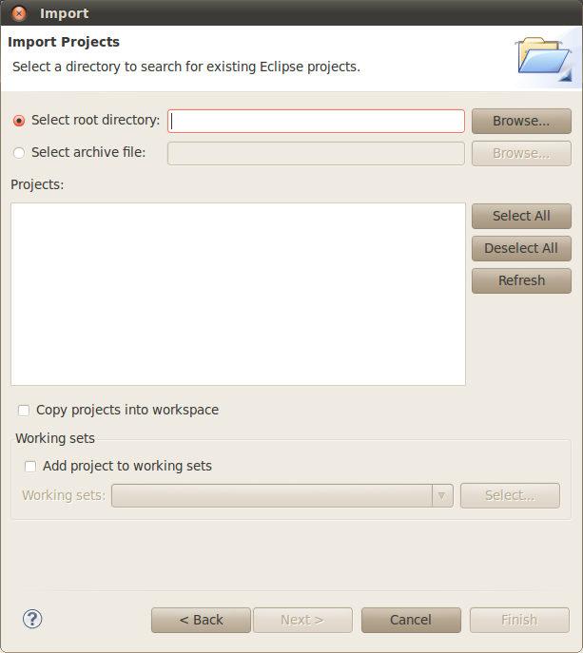
Import an Android Project
In Java Perspective, Menu: File->Import
In Window titled "Select" select "General->Existing Project into Workspace", Click on "Next"
In "Select Root root directory" click on Browse and select the project your want to import. Click on "Finish"

Slide 12
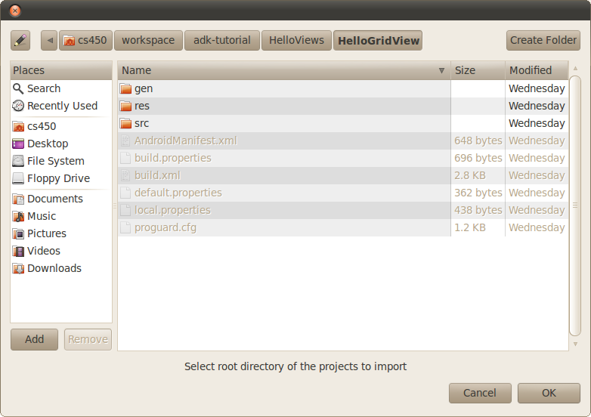
Import an Android Project
Browse into the directory of an Android Project and Click on “OK”

Slide 13
Basic UI components
TextView
Button and EditText
Layouts

Slide 14
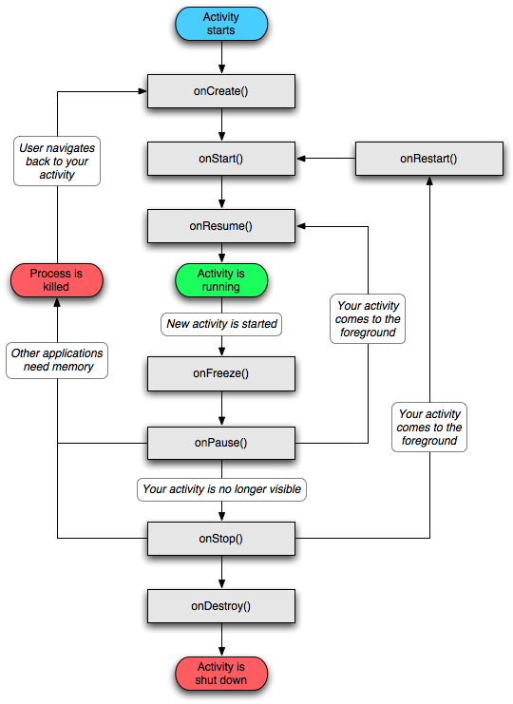
Android “Activity”
What is an Activity
Activity is the base class of a fundamental page in an Android application
Runs like a thread, but...

Slide 15
Android “Message”
How does an Activity talk to anther one?
Operating System maintain a Message Queue
Upon arrival of each message, do a “switch case”
In Activity A:
declare “Handler mHandler =new Handler(){
public void handleMessage(Message msg){
switch (Message msg.what)”
{
case I_AM_HUNGRY:
Make_some_food();
break;
case I_AM_THIRSTY:
Get_some_drinks();
break;
default:
do_nothing();
} } }
In Activity B:
...
Message msg=new Message();
msg.what=I_AM_HUNGRY;
msg.obj=new String(“What I want”);
A.mHandler.sendMessage(msg);

Slide 16
Launch HelloIOIO and HelloIOIOUart
Classroom Demo
Video Demo on Youtube
http://www.youtube.com/watch?v=PLlAtjLKtrQ
1. Connect a tmote to a USB port which is used as an external power supply for IOIO Board
2. Connect droid to the PC, click on the “run” icon
3. When the application is running on a droid, disconnect the PC and connect to the IOIO Board
4. You should be able to see LED on IOIO Board blinking and the command line on Droid is printing data.

Slide 17
Warming up exercise
Implement an EditText with an “Enter” Button that user can type in and print it to a TextView like a command line

Slide 18
Quetions?
or mailto: zzn@jhu.edu
Zainan Victor Zhou

